Slide 1

Accessible Cultural Tourism Train-the-Trainer Program
Project: TACT - Training for Accessible Cultural Tourism
Funded by the European Union. Views and opinions expressed are however those of the author only and do not necessarily reflect those of the European Union or the Foundation Tempus. Neither the European Union nor Foundation Tempus can be held responsible for them.
Notes:
Welcome everyone and thank them for joining.
Briefly introduce yourself, your role, and your experience with accessibility or tourism.
Ask participants to briefly introduce themselves. Who are they, where do they work, what is their motivation for participating in this course?

Slide 2
About the Training Programme
This curriculum is designed to train trainers (ToT) in Accessible Cultural Tourism.
It provides the knowledge, skills, and resources needed for experienced tourism and heritage professionals from Serbia, Bulgaria, and Slovenia to become Accessibility Trainers.
Modules 1-6 are delivered online over 6 weeks. These are the mandatory modules.
Modules 7-9 are delivered in person as three workshops, organized as a part of study visits
Learning materials include:
Power Point presentations
In-depth Learning Materials for all modules - a handbook on accessible tourism
Accessibility guides (Inclusive Customer Service & Communication Guide; Accessibility Site Audit & Assessment Guide; Accessibility Audit of Digital Communication Channels)
Notes:
Explain that this first session of the TACT Train-the-Trainers programme, meaning:
Participants are not only learners,
They are future multipliers who will train others.
Set expectations:
This is an interactive online session, not a lecture.
Participation, reflection, and discussion are essential.
No one is expected to be an expert - learning happens together.

Slide 3
Training Modules
Mandatory modules (online):
MODULE 1: Introduction to Accessible Tourism and Inclusive Customer Service
MODULE 2: Accessibility Standards, Guidelines and Best Practices
MODULE 3: Conducting Accessibility Site Audits and Assessments
MODULE 4: Planning Accessible Infrastructure Improvements
MODULE 5: Assistive Technologies and Digital Accessibility in Tourism
MODULE 6: Promoting and Marketing Accessible Tourism
Additional in-person modules:
MODULE 7: Designing the Local Pilot Trainings
MODULE 8: Conducting Accessibility Assessments and Coaching Others
MODULE 9: Funding Accessibility Projects and Generating Inclusive Tourism Ideas

Slide 4
MODULE 1: Introduction to Accessible Tourism and Inclusive Customer Service
Accessible Cultural Tourism Train-the-Trainer Program
Project: TACT - Training for Accessible Cultural Tourism
Funded by the European Union. Views and opinions expressed are however those of the author only and do not necessarily reflect those of the European Union or the Foundation Tempus. Neither the European Union nor Foundation Tempus can be held responsible for them.
Notes:
Explain WHY THIS MODULE MATTERS
Cultural tourism should be enjoyable – not a struggle
Many visitors still face avoidable barriers
Accessibility is about dignity, participation, and quality experiences
Tourism and culture are meant to be enriching and enjoyable. Yet for many people, visiting a museum or heritage site is stressful, exhausting, or even impossible because of barriers that could have been avoided.
Emphasize: Accessibility is not about perfection. It is about reducing unnecessary barriers and ensuring people are treated with dignity.

Slide 5
Learning Objectives
By the end of this module, participants will be able to:
Explain key concepts of accessible tourism and cultural heritage accessibility (Accessible tourism and “Tourism for All”)
Summarize the benefits and rationale for accessibility - Why Accessibility matters (rights and business case)
Understand Key Principles: Universal Design and the social model of disability
Recognize different access needs and barriers
Adopt inclusive customer service attitudes
Notes:
This module is about building a shared understanding and mindset. It does not yet focus on technical standards or audits, those come later.
Stress especially:
Understanding why accessibility matters
Shifting attitudes and perspectives
Building confidence in interacting with visitors with disabilities
“These objectives are also what your future trainees should gain from this module.”

Slide 6
What is Accessible Tourism?
Accessible Tourism means creating tourism experiences that:
Are usable by as many people as possible
Allow participation with dignity and independence
Address physical, sensory, digital, and attitudinal barriers
Cover the entire visitor experience – before, during, and after the visit
Accessible Tourism - Tourism that enables people to participate regardless of disability, age, or circumstances
Tourism for All - An inclusive approach combining accessibility, sustainability, and social inclusion
Tourism for All
Accessible Tourism
It guarantees the use and enjoyment of tourism irrespective of the capabilities, status or condition of people
Sustainable Tourism
It is involved in the protection of environmental and cultural resources and the wellbeing of communities.
Social Tourism
It aims to guarantee access to tourism to people with low income, families, seniors, or people with disabilities.
Notes:
There are many definitions of Accessible Tourism, and they have evolved over time:
The United Nations describes accessible tourism as an “ongoing endeavour to ensure tourist destinations, products and services are accessible to all people, regardless of their physical limitations, disabilities or age”
Other, more specific definition, states that Accessible Tourism is “tourism and travel that is accessible to all people, with disabilities or not, including those with mobility, hearing, sight, cognitive, or intellectual and psychosocial disabilities, older persons and those with temporary disabilities”. (Takayama Declaration)
“Tourism for All” was initially defined as “That form of tourism that plans, designs and develops leisure and free time tourist activities that can be enjoyed by all types of persons no matter their physical, social or cultural conditions”. It has evolved since, and the term now encompasses Sustainable Tourism, in addition to Accessible Tourism and Social Tourism.
Baker, M. (1989), Tourism for All: A report of the working party

Slide 7
Perception vs Reality
PERCEPTION | REALITY
“It’s all about wheelchairs…” | NOT TRUE. In the UK, only 7% of the disabled market use wheelchairs
“Accessibility is too expensive…” | In many cases, there are many ‘low cost/no cost’ methods of ensuring accessibility. For example: Have a magnifying glass at hand, so a menu can be read by a visually impaired person Incorporate accessibility training into your general staff training
“It’s a niche market…” | Accessible Tourism applies to over 25% of the overall tourism market, and it's growing as populations age.
“We may do or say something wrong and cause offence…” | Accessibility training has been proven to boost staff confidence, enhance customer service, drive repeat business and encourage better customer satisfaction reviews.
Notes:
Why is improving accessibility important?
There are significantly more travellers who have an access need than most people believe.
Approximately one billion people world-wide experience some type of disability.
Including older adults, parents with children etc., the number of travellers who can benefit from accessible accommodations is even larger.
A lack of understanding or awareness of the realities may lead destination stakeholders and businesses to believe that they can’t welcome everyone.
Here are some fact-based rebuttals to a number of common misconceptions
Ensuring accessibility in cultural tourism is important for several reasons. These reasons fall into two categories:
upholding rights and inclusion, and
realizing benefits and opportunities (the “business case”).
We’ll explore both.

Slide 8
Accessibility as a Human Right
Accessibility is primarily about equal rights and basic human dignity.
If a cultural site is open to the public, it should be open to all members of the public.
Exclusion affects:
Independence
Confidence
Sense of belonging
Quality of life
UN Convention on the Rights of Persons with Disabilities (CRPD)
Adopted in 2006
Ratified by most countries worldwide (including Bulgaria, Slovenia and Serbia)
Article 30: Right to access culture, tourism, leisure, and heritage
Notes:
Accessibility is not only a technical issue - it is a human rights issue.
If a barrier exists which prevents someone from entering a building, participating in a tour, or utilizing a service due to their disability, this is not merely an inconvenience.
It is exclusion. And exclusion has real consequences for a person’s independence, confidence and quality of life.
Article 30 of the CRPD specifically affirms the right of persons with disabilities to enjoy cultural life, recreation, leisure and tourism just like anyone else.
This means that governments and institutions are expected to remove barriers and adopt measures so that visiting a heritage site or taking a tour is not a rare privilege for disabled people, but a normal possibility.
Important message for trainers:
Accessibility is not charity.
It is a legal and moral obligation.
Barriers create exclusion
Removing barriers enables participation

Slide 9
Business Case: Benefits of Accessibility
Key trends in accessible tourism demand:
Increase in the population with disabilities
Greater participation of persons with disabilities in tourism
Greater requirements for accessibility in tourism
Accessibility as a positive tool for tourism quality
Reasons to invest in accessibility:
Market potential: Persons with disabilities make up a large and growing market.
Quality: Accessibility increases the quality of offer, and thus the prices too.
Companions: Persons with disabilities generally travel with a companion
Extending the season: Travellers with disabilities tend avoid the peak holiday periods.
Brand profiling: Accessible offerings to boost brand image and be more competitive.
Notes:
Beyond the ethical and legal reasons, there is a very compelling business and economic case for accessibility.
Some organizations only engage when they see financial value.
The business case does not replace the rights-based argument - it reinforces it.
Accessibility is a form of inclusion, which generates additional income.
Key points to explain:
Accessible destinations attract more visitors
Visitors with disabilities often travel with companions
Accessibility improves customer satisfaction for everyone

Slide 10
Accessible Tourism Market in EU
More than 150 million people with access needs in Europe | Average yearly expenditure on tourism more than 80 billion EUR | Loyal customers, often traveling at off-peak season, favouring domestic holidays
Growing number of seniors, by 2025 they will create 35 % of total EU population (UNWTO) | About 800 million trips per year within EU made by people with access needs | They influence decisions where the family or group will go for holiday or where business meeting will take place
Source: European Commission (2014), Economic Impact and Travel Patterns of Accessible Travel in Europe – Final Report
Notes:
These numbers are outdated and conservative, but conclusions are still current.
Loyalty matters. If visitors find a place that treats them well, they:
Return
Recommend it to others
Share experiences within their communities
Off-season travel is important. Older visitors and people with disabilities often prefer:
Less crowded periods
Slower-paced travel
This helps destinations:
Balance visitor flows
Use capacity more efficiently

Slide 11
Key Principles of Accessible Tourism
Universal Design involves designing places, objects and services to be usable by all people, to the greatest extent possible, without the need for adaptation or specialized modifications.
The goal of Universal Design is to make life easier for everyone.
The Social Model of Disability states:
Disability is created by barriers
Not by the person’s impairment
Barriers can be physical, informational, or attitudinal
Medical model: “The person cannot do this”
Social model: “The environment prevents access”
Notes:
Up to now, we have discussed why accessibility matters.
Now we move into how we think about solving accessibility challenges.
If you remember nothing else from this module, remember these two ideas.
Universal Model states: Instead of building something and later adding accessibility as a correction, we design inclusively from the start.
Use an example: A staircase plus a side ramp vs. a single step-free entrance used by everyone.
Stress dignity: Separate entrances or special routes can unintentionally stigmatize visitors.
Universal Design does not mean one solution fits absolutely everyone, it means reducing exclusion as much as possible.
Introduce Social Model as a mindset shift. The social model:
Encourages problem-solving
Empowers tourism professionals
Highlights the importance of attitudes
Makes accessibility achievable

Slide 12
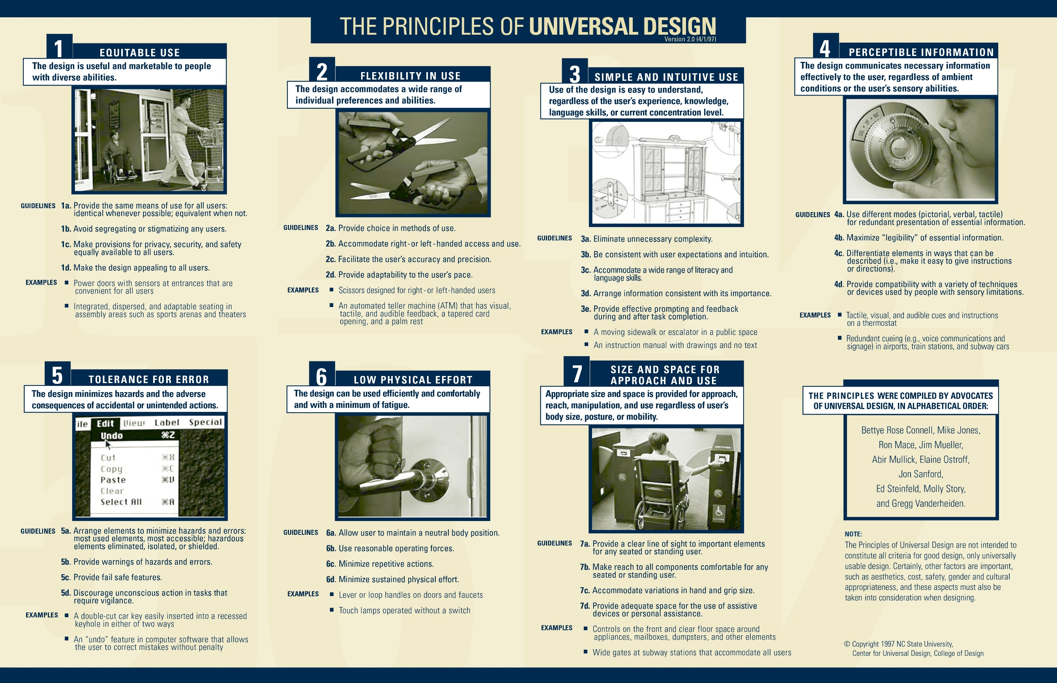
The Principles of Universal Design
Equitable use
Flexibility in use
Simple and intuitive use
Perceptible information
Tolerance for error
Low physical effort
Size and space for approach and use
Illustration: North Carolina State University, The Center For Universal Design
Notes:
There are seven formal principles, but you do not need to memorize them.
What matters is that they help designers and service providers ask better questions.
Examples:
“Is this information understandable without explanation?”
“Does this require unnecessary physical effort?”
“Can people use this in different ways?”
In cultural and heritage settings, Universal Design may include:
Multi-sensory exhibitions
Inclusive tour routes
Clear orientation and wayfinding
Accessible websites and booking systems
Integrated accessibility solutions

Slide 13
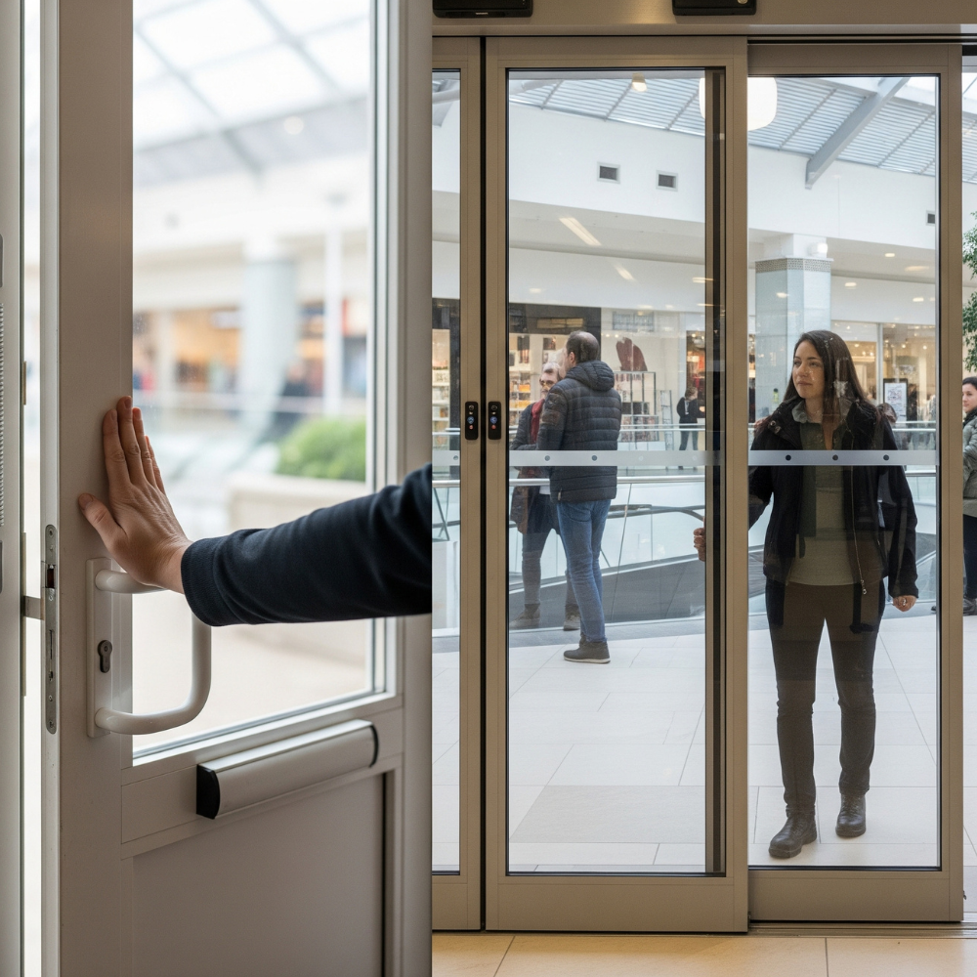
Universal Design 1: EQUITABLE USE
The design is useful and marketable to people with diverse abilities.
GUIDELINES
1a. Provide the same means of use for all users: identical whenever possible; equivalent when not. 1b. Avoid segregating or stigmatizing any users. 1c. Make provisions for privacy, security, and safety equally available to all users. 1d. Make the design appealing to all users.
EXAMPLES
Power doors with sensors at entrances that are convenient for all users
Integrated, dispersed, and adaptable seating in assembly areas such as sports arenas and theaters
Image source: https://www.quikoitaly.com/

Slide 14

Universal Design 2: FLEXIBILITY IN USE
The design accommodates a wide range of individual preferences and abilities.
GUIDELINES
2a. Provide choice in methods of use. 2b. Accommodate right- or left-handed access and use. 2c. Facilitate the user’s accuracy and precision. 2d. Provide adaptability to the user’s pace.
EXAMPLES
Scissors designed for right- or left-handed users
An automated teller machine (ATM) that has visual, tactile, and audible feedback, a tapered card opening, and a palm rest
Image source: https://www.bangstyle.com/

Slide 15
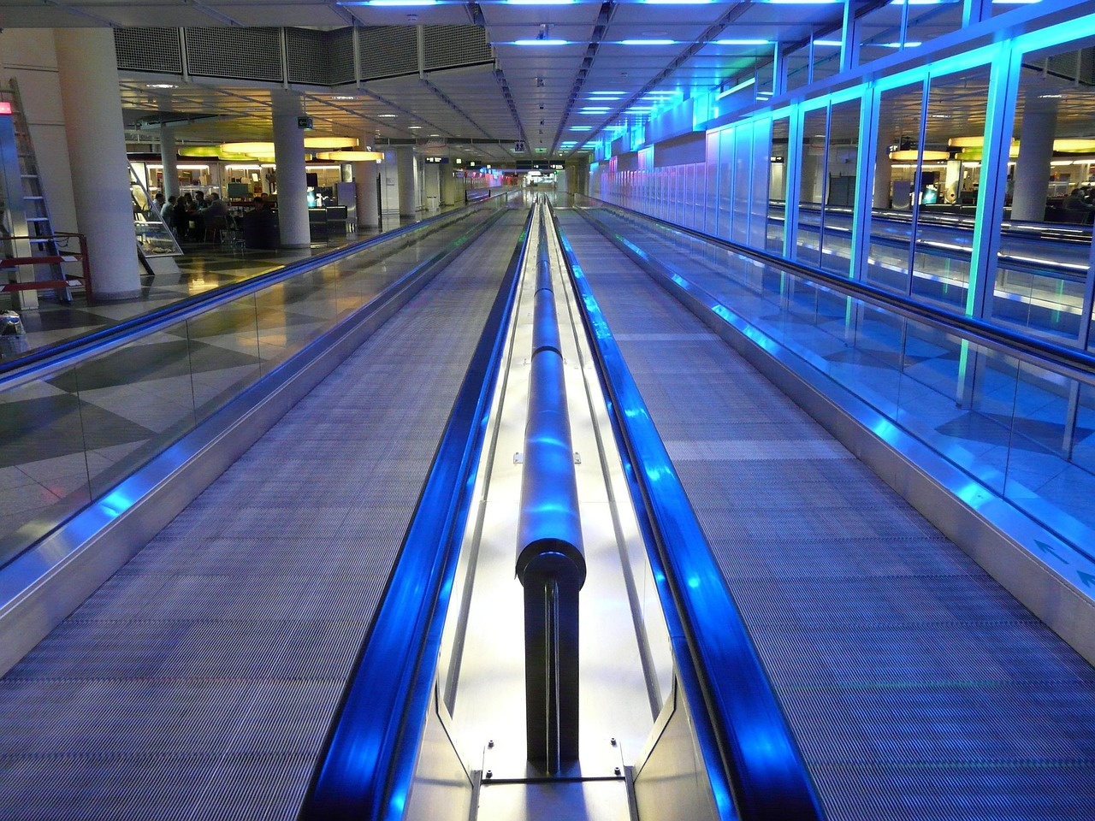
Universal Design 3: SIMPLE AND INTUITIVE USE
Use of the design is easy to understand, regardless of the user’s experience, knowledge, language skills, or current concentration level.
GUIDELINES
3a. Eliminate unnecessary complexity. 3b. Be consistent with user expectations and intuition. 3c. Accommodate a wide range of literacy and language skills. 3d. Arrange information consistent with its importance. 3e. Provide effective prompting and feedback during and after task completion.
EXAMPLES
A moving sidewalk or escalator in a public space
An instruction manual with drawings and text
Image source: https://pixabay.com/

Slide 16
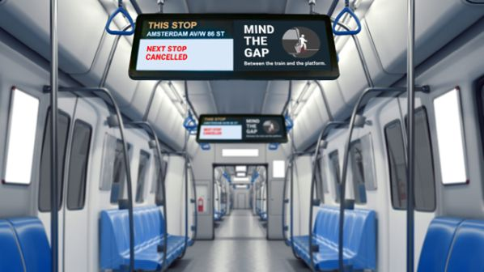
Universal Design 4: PERCEPTIBLE INFORMATION
The design communicates necessary information effectively to the user, regardless of ambient conditions or the user’s sensory abilities.
GUIDELINES
4a. Use different modes (pictorial, verbal, tactile) for redundant presentation of essential information. 4b. Maximize “legibility” of essential information. 4c. Differentiate elements in ways that can be described (i.e., make it easy to give instructions or directions). 4d. Provide compatibility with a variety of techniques or devices used by people with sensory limitations.
EXAMPLES
Tactile, visual, and audible cues and instructions on a thermostat
Redundant cueing (e.g., voice communications and signage) in airports, train stations, and subway cars
Image source: https://www.railjournal.com/

Slide 17

Universal Design 5: TOLERANCE FOR ERROR
The design minimizes hazards and the adverse consequences of accidental or unintended actions.
GUIDELINES
5a. Arrange elements to minimize hazards and errors: most used elements, most accessible; hazardous elements eliminated, isolated, or shielded. 5b. Provide warnings of hazards and errors. 5c. Provide fail-safe features. 5d. Discourage unconscious action in tasks that require vigilance.
EXAMPLES
A double-cut car key easily inserted into a recessed keyhole in either of two ways
An “undo” feature in computer software that allows the user to correct mistakes without penalty
Image source: https://pixabay.com/

Slide 18
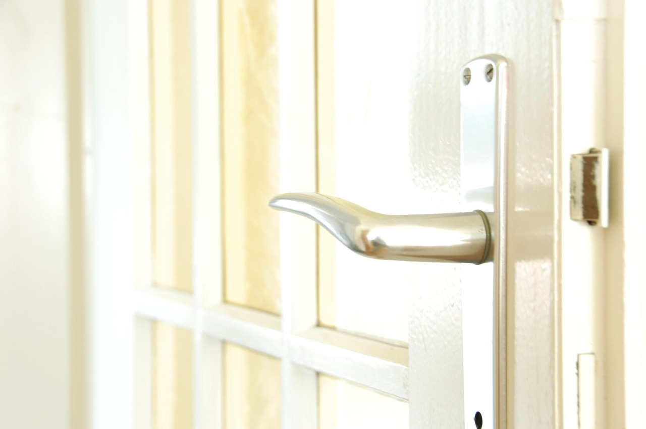
Universal Design 6: LOW PHYSICAL EFFORT
The design can be used efficiently and comfortably and with a minimum of fatigue.
GUIDELINES
6a. Allow user to maintain a neutral body position. 6b. Use reasonable operating forces. 6c. Minimize repetitive actions. 6d. Minimize sustained physical effort.
EXAMPLES
Lever or loop handles on doors and faucets
Touch lamps operated without a switch
Image source: https://pixabay.com/

Slide 19
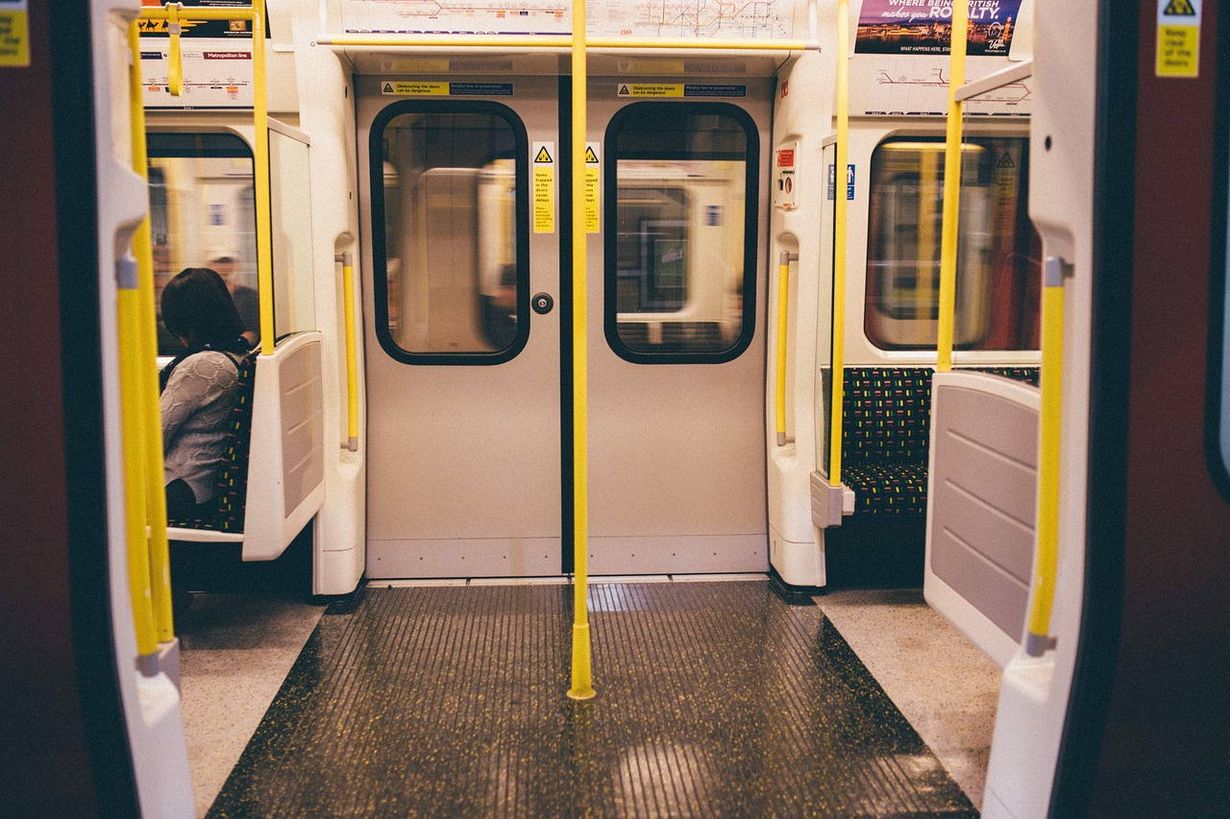
Universal Design 7: SIZE AND SPACE FOR APPROACH AND USE
Appropriate size and space is provided for approach, reach, manipulation, and use regardless of user’s body size, posture, or mobility.
GUIDELINES
7a. Provide a clear line of sight to important elements for any seated or standing user. 7b. Make reach to all components comfortable for any seated or standing user. 7c. Accommodate variations in hand and grip size. 7d. Provide adequate space for the use of assistive devices or personal assistance.
EXAMPLES
Controls on the front and clear floor space around appliances, mailboxes, dumpsters, and other elements
Wide gates at subway stations that accommodate all users
Image source: https://pixabay.com/

Slide 20
Beneficiaries of Accessible Tourism
Persons with disabilities
Physical
Sensory
Intellectual
Other population groups
Elderly people
Foreigners
Others
Others include:
People with pushchairs and prams
Pregnant women
Persons with a temporary disability
Persons with injuries
Persons with obesity, or of very tall or very short stature;
Persons carrying large items
Children
People accompanying persons with disabilities
Persons with allergies and/or food intolerances.
Notes:
Accessibility is not one-size-fits-all
People experience different access needs
Barriers vary depending on the individual and the context
Many accessibility solutions benefit multiple groups
Awareness is the first step to inclusion

Slide 21
Disabilities and Barriers
Mobility Impairments
People who use wheelchairs, scooters, crutches, or have difficulty walking or standing for long periods (for example, many seniors). Common barriers for this group are physical obstacles in the built environment.
Visual Impairments
Include total blindness, through partial sight (low vision). Barriers here are information and orientation related.
Hearing Impairments
Includes people who are deaf or hard of hearing. The obvious barriers involve anything audio or spoken.
Cognitive or Intellectual Disabilities
Include autism spectrum disorders and other cognitive impairment. Barriers here often involve complexity and sensory overload.
Other / Hidden Disabilities
Individuals with chronic health issues, chronic pain, or fatigue disorders; epilepsy; panic disorder; PTSD

Slide 22
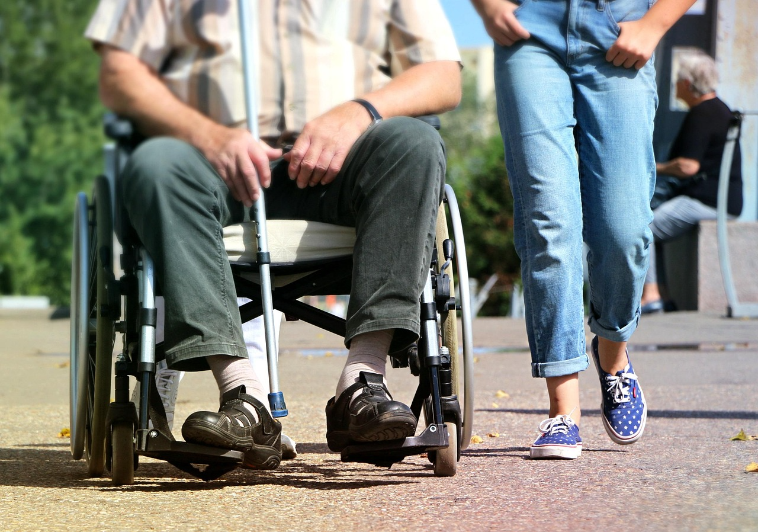
Persons with Mobility Impairments
The basic requirements for an accessible offering include:
Paths and entrances without steps
No thresholds or steps
Doorways that are sufficiently wide
Stairs with easy-grip hand rails
Plenty of places to sit
Enough room to move and get around indoors
Enough space and storage areas for walking frames
Accessible sanitation facilities
Image source: https://pixabay.com/
Notes:
Clarify that mobility impairments include:
Wheelchair users
People using crutches or walkers
Older visitors
People who can walk but not for long distances
Mobility-related barriers often include:
Steps or level changes without alternatives
Narrow doorways or tight spaces
Long walking distances or uneven surfaces
Lack of seating or accessible toilets
Give examples:
Seating every few rooms
Clear step-free routes
Accessible drop-off points

Slide 23
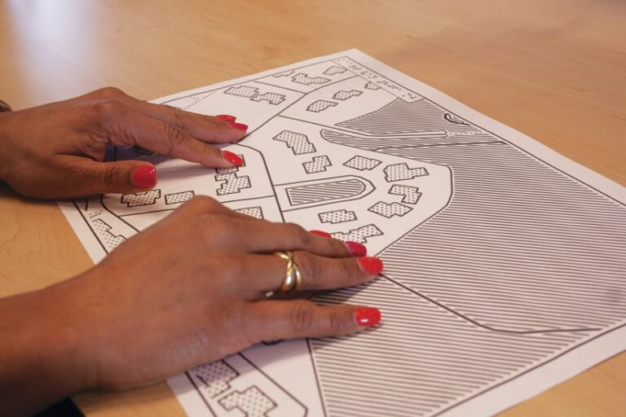
Persons with Visual Impairments
The basic requirements for an accessible offering for visually impaired people include:
Text in a suitable font size
Pictograms, switches, handles, orientation aids, etc. in clearly contrasting colours
Good light conditions and room lighting
Illuminated strips or contrasting strips on stairs and glass doors
The basic requirements for an accessible offering for blind people include:
Audible information
The option of taking guide dogs
Information in Braille or raised tactile lettering
Tactile flooring and paving
Accessible websites
Image source: https://www.esri.com/
Notes:
Visual impairment includes:
Blindness
Low vision
Partial sight
Common barriers for visitors with visual impairments:
Information presented only visually
Poor contrast or small text
Lack of orientation cues
Unexpected obstacles in pathways
Information accessibility is essential
Explain good practice:
Audio descriptions
Large-print materials
Tactile maps or models
Clear lighting and contrast

Slide 24

Persons with Hearing Impairments
The basic requirements for an accessible offering include:
Adding visual information to audible information, for example subtitles in videos
Providing written information
Maintaining eye contact and speaking clearly
Using sign language interpreters if necessary
Image source: https://pexels.com/
Notes:
Hearing impairment includes:
Deaf visitors
Hard-of-hearing visitors
People who rely on hearing aids or cochlear implants
Common barriers for Deaf and hard-of-hearing visitors:
Audio-only tours or announcements
No captions or transcripts
Poor visibility for lip-reading
Lack of visual emergency information
Visual alternatives are critical
Highlight good practices:
Subtitles on videos
Written summaries
Clear visual alerts
Facing the person when speaking
Stress safety: Emergency information must never be audio-only.

Slide 25
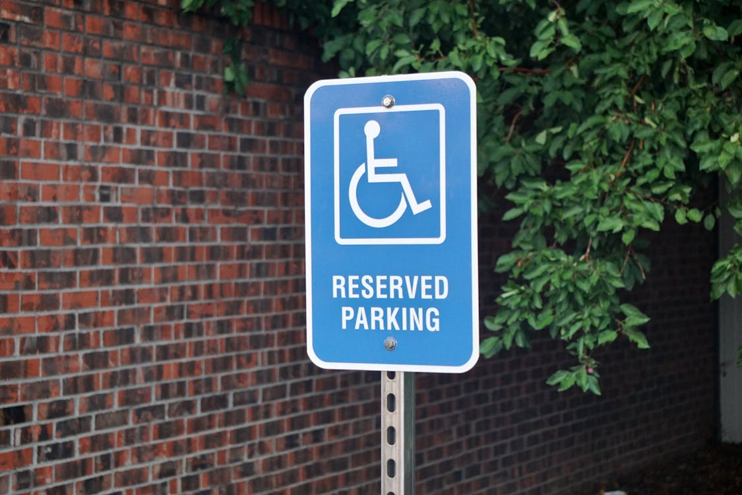
Persons with Cognitive or Intellectual Disabilities
The basic requirements for an accessible offering include:
The concept of simple language (verbal communication in short, simple, grammatically correct sentences)
Writing text in short, simple, grammatically correct sentences
Providing information in simple language
Using images such as photos or symbols
Image source: https://pexels.com/
Notes:
Explain that this group includes:
People with intellectual disabilities
People on the autism spectrum
People with dementia or brain injuries
People with learning difficulties
Barriers may include:
Complex language or long explanations
Information overload
Crowded, noisy, or bright environments
Unclear structure or expectations
Clarity, calm, and predictability help
These visitors are often excluded unintentionally through:
Jargon
Fast-paced tours
Sensory overload
Explain good practices:
Simple language
Visual supports
Quiet spaces
Sensory-friendly time slots
Key message: “Accessibility is not about dumbing down - it’s about clarity.”

Slide 26
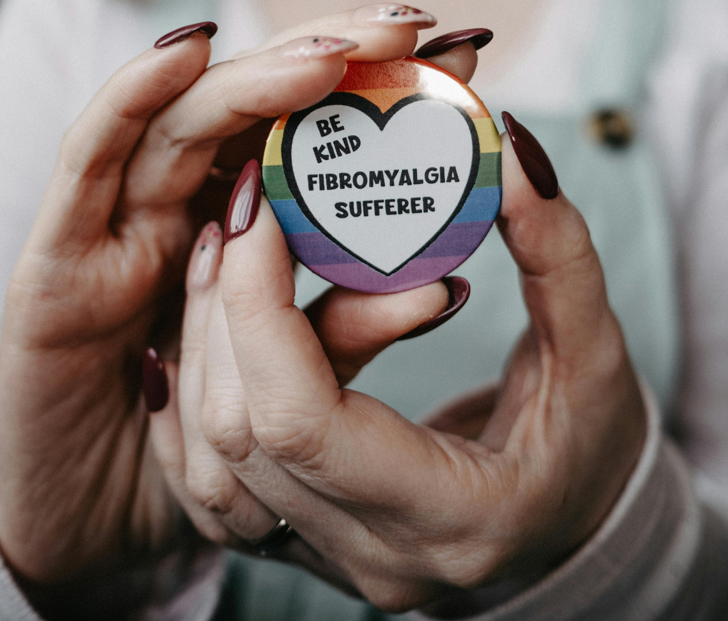
Other / Hidden Disabilities
Not all disabilities are visible.
Examples include:
Chronic pain or fatigue
Anxiety or panic disorders
Sensory sensitivities
Temporary illness or injury
Flexibility and empathy are essential.
A calm, non-judgmental response can make all the difference.
Image source: https://pexels.com/
Notes:
Many visitors will never disclose a disability. They may simply appear tired, anxious, or overwhelmed.
Give examples:
Someone needing frequent breaks
Someone leaving a room suddenly
Someone avoiding crowds or noise
* Fibromyalgia - a chronic disorder characterized by widespread pain and other symptoms such as fatigue, muscle stiffness, and insomnia.

Slide 27
Accessibility is Also About Attitude
Accessibility is as much about attitude as infrastructure.
Buildings and technology matter.
But people make the difference.
Staff attitudes shape the visitor experience.
It is possible for a site with imperfect infrastructure to provide a good experience through excellent staff attitudes.
It is equally possible for a technically accessible site to fail visitors because of poor interaction.
Notes:
Use examples:
Friendly staff offering alternatives when a lift is broken
Staff who avoid eye contact or speak only to companions
Emphasize:
Accessibility lives in everyday interactions - greetings, tone of voice, willingness to help.
Key message: “Attitude can remove or create barriers in seconds.”

Slide 28
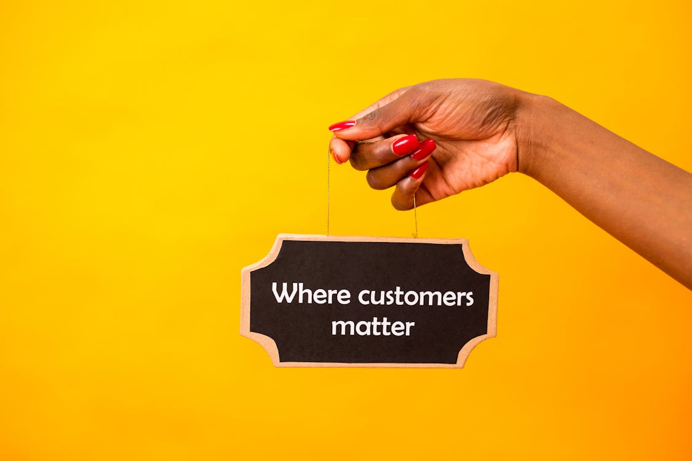
Principles of Inclusive Customer Service
Respect and Courtesy Above All
Ask Before Helping
Listen to and Trust the Visitor
Use Appropriate Language
Be Patient and Attentive
Provide a Welcoming Atmosphere
Know the Do’s and Don’ts of Specific Interactions
Stay Positive and Composed
Treat visitors with disabilities as valued customers/guests they are
Image source: https://pexels.com/
Notes:
Respect and Courtesy Above All
Treat visitors with disabilities the same way you would any other guest, with respect, patience, and genuine courtesy. Speak directly to the person, use a normal tone, and remember that disability does not define their interests or personality.
Ask Before Helping
Never assume help is needed. A simple “May I help you?” respects independence and ensures assistance is wanted before you step in or touch personal equipment.
Listen to and Trust the Visitor
Visitors are the experts in their own needs. If they tell you what works or what does not, take them at their word and follow their lead.
Use Appropriate Language
Choose respectful, neutral language that puts the person first and avoids outdated or negative terms. When unsure, focus on the service or accommodation rather than labeling the person.
Be Patient and Attentive
Some guests may need more time to communicate or move through the experience. Staying calm, listening fully, and not rushing sends a clear message that they are welcome.
Provide a Welcoming Atmosphere
Let visitors know from the start that accessibility is expected and supported. Small, natural gestures of inclusion help guests feel they belong, not like an exception.
Know the Do’s and Don’ts of Specific Interactions
Basic etiquette matters, such as not leaning on wheelchairs, facing people who lip-read, and asking before offering physical guidance. These small actions make interactions more comfortable and respectful.
Stay Positive and Composed
When things do not go as planned, stay calm and focus on solutions rather than the problem. Handle accommodations as a normal part of the day so no one feels like a burden.

Slide 29
Do’s and Don’ts in Practice
DO speak directly to the person (not to a caregiver or companion as if the person isn’t there).
DO ask if they require assistance and how, prior to attempting to assist them.
DO communicate clearly and concisely and confirm their understanding of communication if necessary.
DO offer the same options and choices to a person with a disability as you would others (for example, asking “Would you like an audio guide or a written guide?” rather than assuming they only want one format).
DO be patient, and give the person time to move or communicate. Relax and be yourself.
DON’T assume you know what’s best for them, listen to their requests.
DON’T make patronizing statements (avoid statements such as “You’re so inspirational for being here,” which can be perceived as demeaning).
DON’T touch someone’s assistive device (wheelchair, cane, hearing aid, etc.) without permission.
DON’T draw unnecessary attention to the persons’ disability, focus on the visitor experience.
Notes:
For example:
it’s okay to discreetly mention to a blind visitor that you have tactile exhibits for them
but there’s no need to announce to the whole group “We have a blind person so everyone wait while I do this,” etc.
Inclusion works best when it’s seamlessly integrated.
Attitude is contagious.
If the staff and guides approach accessibility with positivity and normalcy, other visitors will follow that lead, and the overall environment becomes more inclusive.
It’s okay not to be an expert on every disability. If you’re unsure how to help someone, ask them politely.
For instance, “Is there anything I can do to make your visit more comfortable?” or “Let me know if you need any assistance I am happy to help."

Slide 30
Key Takeaways
Accessibility and Dignity: Accessible tourism is about equal participation and dignity, ensuring everyone can enjoy culture and heritage without facing unnecessary barriers or exclusion.
Accessibility as Good Business: Making tourism accessible attracts a wider range of visitors, encourages loyalty, and improves overall quality, making it a smart and sustainable business choice.
Designing for Inclusion: Universal Design and the social model of disability help staff plan experiences that remove barriers early and focus on fixing environments and attitudes, not people.
Understanding Diverse Needs: Access needs vary widely, but many thoughtful solutions support multiple visitors at once and improve the entire visitor journey.
The Power of Attitudes and Service: How staff communicate, listen, and respond often matters as much as physical access, shaping whether visitors feel truly welcome.

Slide 31
THANK YOU!
Do you have any questions?
What was new or surprising for you?

